Slide 1

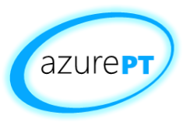
Azure Service Fabric^{PREVIEW} Overview
João Pedro Martins
26.Mar.2016

Slide 2

João Pedro “jota” Martins
Software Architect
Microsoft Azure Insider + Advisor
Co-founder - GASP + APPU
TechEd 2006 – “Iron Architect” Winner
BizTalk Server MVP 2006-2011

Slide 3
Ground Rules and Expectations
This is based on a non-RTM SDK:
there will be problems ☹
This is a different way of architecting software:
there will be many disagreements ☺
There is a lot to say:
there won’t be enough time ☹
Notes:
The demos are based in software that is in preview. Problems are to be expected.
The programming model underlying this approach is different from what has been the best practice in the age of SOA.
Questions: [Hands raised]
Who has used Azure Web and Worker Roles?
Who has developed services-driven systems with stateless services?

Slide 4
What’s this session about?
Microsoft Azure Service Fabric
= A platform for reliable, hyperscale, microservice-based applications
= PaaS v2 + Stateful Services/Actors
= Platform for applications BORN FOR THE CLOUD, not Lift&Shift’ed
Notes:
Service Fabric enables you to build and manage scalable and reliable applications composed of microservices running at very high density on a shared pool of machines (commonly referred to as a Service Fabric cluster).
Powers a huge set of Microsoft Services: Azure SQL Database, Azure DocumentDB, Cortana, Power BI, Microsoft Intune, Azure Event Hubs, Skype for Business and others
It provides a sophisticated runtime for building distributed, scalable stateless and stateful microservices.
Also provides comprehensive application management capabilities for provisioning, deploying, monitoring, upgrading/patching, and deleting deployed applications.
Service Fabric is tailored to creating “born in the cloud” services that can start small, as needed, and grow to massive scale with hundreds or thousands of machines, creating Service Fabric clusters across availability sets in a region or across regions.

Slide 5

the platform

Slide 6
Microsoft Azure Service Fabric A platform for reliable, hyperscale, microservice-based applications
Microservices
Service Fabric
Container Orchestration & lifecycle management
Application Programming Models
High Availability
Hybrid Operations
Data Partitioning
Health Monitoring
Self-healing
Simple programming models
High Density
Rolling Upgrades
Low Latency
Placement Constraints
Replication & Failover
Stateful services
Fast startup & shutdown
Load balancing
Hyper-Scale
Automated Rollback
Management
Communication
Reliability
Hosting
Subsystem
Testability
Windows
Server
Linux
Windows
Server
Linux
Azure
Hosted Clouds
Federation
Windows
Server
Linux
Private Clouds
Transport
Notes:
Service Fabric enables you to build and manage scalable and reliable applications composed of microservices running at very high density on a shared pool of machines (commonly referred to as a Service Fabric cluster).
Powers a huge set of Microsoft Services: Azure SQL Database, Azure DocumentDB, Cortana, Power BI, Microsoft Intune, Azure Event Hubs, Skype for Business and others
It provides a sophisticated runtime for building distributed, scalable stateless and stateful microservices.
Also provides comprehensive application management capabilities for provisioning, deploying, monitoring, upgrading/patching, and deleting deployed applications.
Service Fabric is tailored to creating “born in the cloud” services that can start small, as needed, and grow to massive scale with hundreds or thousands of machines, creating Service Fabric clusters across availability sets in a region or across regions.

Slide 7
Battle-hardened for over 5 years
Skype for Business
Hybrid Ops
Azure Document DB
billions transactions/week
Intune
800k devices
Azure Core Infrastructure
thousands of machines
Event Hubs
20bn events/day
Bing Cortana
500m evals/sec
Azure SQL Database
1.4 million databases
Power BI
… and the Halo 4 multiplayer as “Project Orleans”

Slide 8
Service Fabric Capabilities
Application deployment services:
Rolling update with rollback
Strong versioning
Side-by-side support
Leadership election
Name service for discovery of applications
High density
Partitioning support
Load balancing and placement constraints
Consistent state replication framework
Reliable distributed key/value store, collections and queues

Slide 9
Service Fabric Microservices
A microservice is whatever you want it to be:
ASP.NET, node.js, Java VMs, an arbitrary .exe
Stateless microservices
A microservice that has state where the state is persisted to external storage, such as Azure databases or Azure storage
Stateful microservices
Reliability of state through replication and local persistence
Reduces the complexity and number of components in traditional three-tier architecture

Slide 10
Service Fabric vs. Cloud Services
evolution
Cloud Services
Service Fabric

Slide 11

Cluster: A federation of machines
A set of machines that Service Fabric stitches together to form a cluster
Clusters can scale to
1000s of machines
Node
Node
Node
Node
Node
Node

Slide 12




Cluster: System view
System Services
Failover
manager
Cluster
manager
Naming
Image
store

Slide 13
Reconfiguration
Types of reconfiguration
Primary failover
Removing a failed secondary
Adding recovered replica
Building a new secondary
X
Failed
P
S
P
B
S
S
X
Failed
S
S
Must be safe in the presence of cascading failures

Slide 14

Upgrading Services with zero downtime
FD1/UD6
Application Package
FD0/UD0
FD1/UD5
FD0/UD1
FD2/UD4
FD2/UD3
FD – Failure Domain; UD – Upgrade Domain

Slide 15
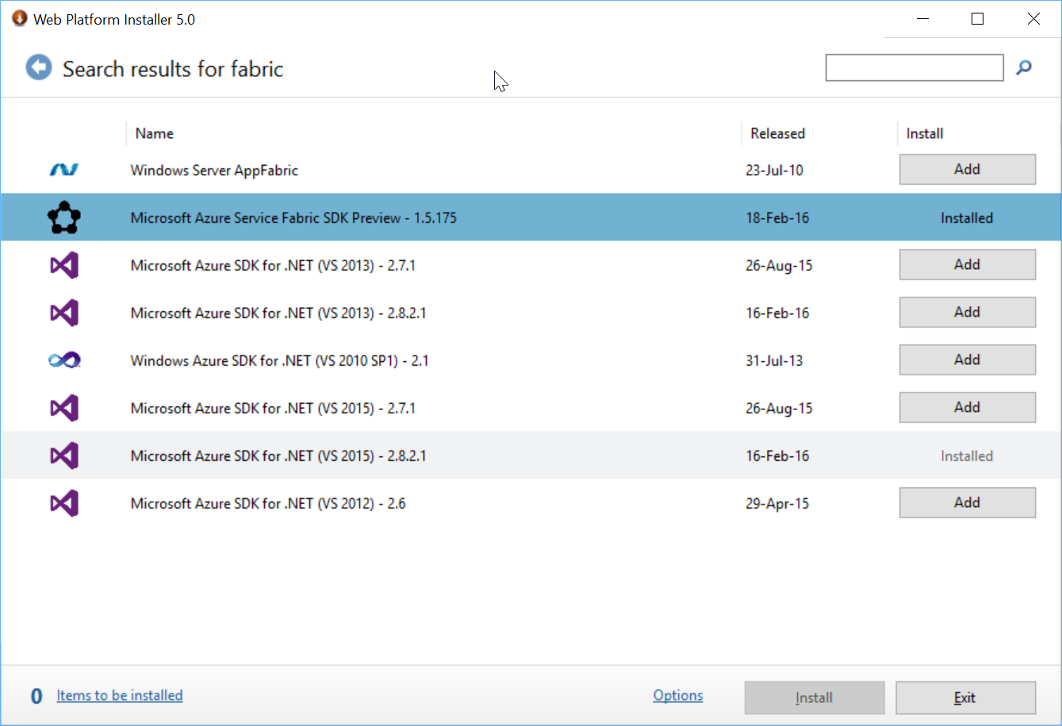
Basics for devs
Download from WebPI
Sets up local dev cluster with 5 nodes by default
Includes service fabric explorer + powershell cmdlets
Same code that runs on Azure

Slide 16
Stateless service + Automatic Failover
demo

Slide 17

the programming model

Slide 18
What is a microservice?
Is (logic + state) that is independently versioned, deployed, and scaled
Has a unique name that can be resolved (e.g. fabric:/myapplication/myservice)
Interacts with other microservices over well defined interfaces and protocols like REST
Remains always logically consistent in the presence of failures
Hosted inside a “container” node (code + config)
Can be written in any language/framework (node.js, Java VMs, any EXE)
Developed by a small engineering team

Slide 19
Types of microservices
Stateless microservice
Has either no state or it can be retrieved from an external store
There can be N instances
e.g. web frontends, protocol gateways, Azure Cloud Services etc.
Stateful microservice
Maintain hard, authoritative state
N consistent copies achieved through replication and local persistence
e.g. database, documents, workflow, user profile, shopping cart, IoT devices, multiplayer games, etc.

Slide 20






3-Tier service pattern
Load Balancer
Scale with partitioned storage
Increase reliability with queues
Reduce read latency with caches
Manage your own transactions for state consistency
Many moving parts each managed differently
Front End
(Stateless
Web)
Stateless
Middle-tier
Compute
Cache
Queues Storage

Slide 21

Stateful services: Simplify design, reduce latency
Application state lives in the compute tier
Low Latency reads and writes
Partitions are first class for scale-out
Built in transactions
Fewer moving parts
Load Balancer
Front End
(Stateless
Web)
Stateful
Middle-tier
Compute
data stores used for analytics and disaster recovery

Slide 22
Stateful microservice
Application Package
replication
replication
S
S
P
S
S
P

Slide 23
Service Fabric Programming Models
Applications composed of microservices
Reliable Services API
Reliable Actors API
Service Fabric
Health Monitoring
Container Orchestration & lifecycle management
High Availability
Hybrid Operations
Data Partitioning
Self-healing
Simple programming models
High Density
Rolling Upgrades
Low Latency
Placement Constraints
Replication & Failover
Stateful services
Fast startup & shutdown
Load balancing
Hyper-Scale
Automated Rollback
Azure
Private Clouds
Notes:
There are two programming models available in Service Fabric to build applications:
Reliable services: An API to build stateless and stateful services based on StatelessService and StatefulService .NET classes and store state in .NET reliable collections (dictionary and queue). They also have the ability to plug in a variety of communication stacks, such as Web API and Windows Communication Foundation. This programming model is suitable for applications where you need to perform compute across multiple units of state.
Reliable actors: An API to build stateless and stateful objects through the virtual actor programming model that is suitable for applications with multiple independent units of state and compute.

Slide 24
Reliable Services API
Build stateless services using existing technologies such as ASP.NET
Build stateful services using reliable collections
ReliableDictionary<T>, ReliableQueue<T>
Data Contract Serializer
Manage the concurrency and granularity of state changes using transactions
Communicate with services using the technology of your choice
e.g. WebAPI , WCF
Collections
Concurrent Collections
Reliable Collections
Single machine
Single threaded
Single machine
Multi threaded
Multi machine
Multi threaded
Replicated (HA)
Persistence
Asynchronous
Transactional
Notes:
https://azure.microsoft.com/en-us/documentation/articles/service-fabric-reliable-services-reliable-collections/
Reliable Collections can be thought of as the natural evolution of the System.Collectionsclasses: a new set of collections that are designed for the cloud and multi-computer applications without increasing complexity for the developer. As such, Reliable Collections are:
Replicated: State changes are replicated for high availability.
Persisted: Data is persisted to disk for durability against large-scale outages (for example, a datacenter power outage).
Asynchronous: APIs are asynchronous to ensure that threads are not blocked when incurring IO.
Transactional: APIs utilize the abstraction of transactions so you can manage multiple Reliable Collections within a service easily.
Reliable Collections provide strong consistency guarantees out of the box in order to make reasoning about application state easier. Strong consistency is achieved by ensuring transaction commits finish only after the entire transaction has been applied on a quorum of replicas, including the primary. To achieve weaker consistency, applications can acknowledge back to the client/requester before the asynchronous commit returns.
The Reliable Collections APIs are an evolution of concurrent collections APIs (found in theSystem.Collections.Concurrent namespace):
Asynchronous: Returns a task since, unlike concurrent collections, the operations are replicated and persisted.
No out parameters: Uses ConditionalResult to return a bool and a value instead of out parameters. ConditionalResult is like Nullable but does not require T to be a struct.
Transactions: Uses a transaction object to enable the user to group actions on multiple Reliable Collections in a transaction.

Slide 25
Stateful service + Automatic Failover
demo

Slide 26
Service Fabric Programming Models
Applications composed of microservices
Reliable Services API
Reliable Actors API
Service Fabric
Health Monitoring
Container Orchestration & lifecycle management
High Availability
Hybrid Operations
Data Partitioning
Self-healing
Simple programming models
High Density
Rolling Upgrades
Low Latency
Placement Constraints
Replication & Failover
Stateful services
Fast startup & shutdown
Load balancing
Hyper-Scale
Automated Rollback
Azure
Private Clouds

Slide 27
Reliable Actors API
Build reliable stateless and stateful objects with a virtual actor programming model
Finally, we have Object-Oriented Microservices
Suitable for applications with multiple independent units of state and compute
Automatic activation management
Automatic state management and turn based concurrency (single threaded execution)

Slide 28
Rolling upgrades with no downtime (+ actors)
demo

Slide 29
(some demo with Actors. IoT? Shopping carts?)
demo

Slide 30
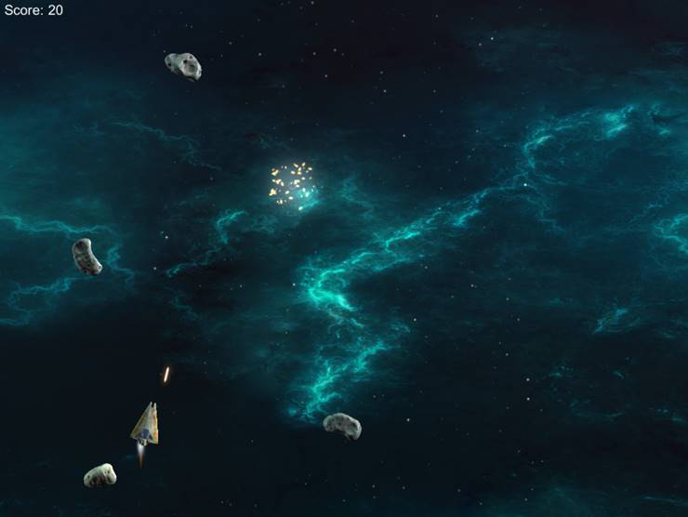
Actoroids Architectural example
Gateway
You are destroyed
Ship
Turn
Ships
Asteroids
Bolts
Scores
Velocity
Health
Position
Name
Fire!
Accelerate/brake
Join a session
makes all kinds of decisions
move
Get state
commands
Get state
You are launched
Get state
Get state
You are destroyed
You hit something
Asteroid
Get state
Bolt
Velocity
Position
IsEvil?
Velocity
Decay
Position
evil? chase(): move()
move

Slide 31
Azure Compute Continuum
IaaS
PaaS
VMs /
VM Scale Sets
VM Extensions
Service Fabric /
Batch
Web Apps/
App Service
Ultimate
Control
Rapid
Development

Slide 32
Service Fabric Roadmap
Azure Service
GA H1 2016
Windows Server 2012 R2/Windows Server 2016 TP1
Public preview Feb 2016
GA June 2016 for WS2012 R2 and WS2016 RTM (Includes integration with Windows containers)
Azure Stack
Targeting H2 2016
Linux
(Includes integration with Docker containers)
Private preview April 2016
Public preview H2 2016
GA H2 2016

Slide 33
References
Service Fabric
http://aka.ms/ServiceFabric
Service Fabric Documentation
http://aka.ms/ServiceFabricdocs
Service Fabric Samples
https://azure.microsoft.com/en-us/documentation/samples/?service=service-fabric
https://github.com/Azure-Samples/service-fabric-dotnet-getting-started
Akka.net (the other .Net implementation of the Actor Model)
http://getakka.net/
Actor Model (1973)
https://en.wikipedia.org/wiki/Actor_model
Martin Fowler on Microservices
http://martinfowler.com/articles/microservices.html

Slide 34

THANK YOU! QUESTIONS?
João Pedro “jota” Martins
Joao.pedro.martins@gmail.com
(+351) 96 782 5537 blog.joaopedromartins.net
@lokijota
pt.linkedin.com/in/joaopedromartins/
Notes:
Logo font: Monserrat Regular
Logo color: #9a8e5e (154,142,94)

Slide 35
Backup slides

Slide 36
Programming Models
There are two programming models available in Service Fabric to build applications:
Reliable services: An API to build stateless and stateful services based on StatelessService and StatefulService .NET classes and store state in .NET reliable collections (dictionary and queue). They also have the ability to plug in a variety of communication stacks, such as Web API and Windows Communication Foundation. This programming model is suitable for applications where you need to perform compute across multiple units of state.
Reliable actors: An API to build stateless and stateful objects through the virtual actor programming model that is suitable for applications with multiple independent units of state and compute.

Slide 37
Extending App With Reliable State
Each partition is 1 Primary Replica + n Secondary Replicas
State is replicated to Active Secondary(s) “replicas” in order.
Writes are completed when they are successfully replicated to a majority quorum.
Named Partitions: Partition per genre.
Range Partitions: Pn =(high key-low key)/# of Ps
Singleton Partition

Slide 38
On Applications, Hosts & Activation
Applications are packages, copied to the cluster (System:Image Store Service), then registered as ApplicationType and ApplicationTypeVersion with Service Fabric.
Application instance is based on ApplicationType & ApplicationTypeVersion defines process isolation boundaries, while partition defines data isolation boundaries.
ApplicationManifest’s DefaultServices are activated with every app instance.
VS.NET tooling creates 1 App Instance when you F5 or Publish.
Services are defined as a ServiceType with ServiceTypeVersion in a Service Package that also has Code, Config & Data packages (each package is versioned).
Code = host, host is a process created per node per Application per service type. Optionally: can also have a Setup EntryPoint. Replicas are activated in host process.

Slide 39
On Rolling Upgrades
Hosts are taken down during Code package updates, but not during Config or Data packages upgrades.
Upgrades are performed on Cluster Update Domains.
Upgrades Types
Monitored Auto: UD one by one , health checks and failure action: (can do auto roll back).
Unmonitored Auto: UD one by one, no health checks.
Unmonitored Manual: You manually upgrade each UD.
Protip: use Upgrade Parameters to control the upgrade process.

